Slide 1
Explain Like I’m 12 (ELI12)
Offline mini-tutor: simplify → key terms → examples → mini-quiz
What it does
Best for
Paste a textbook paragraph
Get a simplified explanation (levels)
See key terms + glossary + quiz
Copy / download results for study
Students who struggle with dense text
Quick self-check before tests
Offline classroom / low internet
Notes:
[
Sources
]

Slide 2
Problem
Textbooks are dense; students need fast clarity and self-check.
Pain points
What students want
Long sentences + unfamiliar terms
Hard to find the “main idea” quickly
No instant practice to confirm understanding
Internet/API access is not always available
Simple explanation in seconds
Glossary of key terms
Real-life examples
Mini-quiz + suggested answers
Notes:
[
Sources
]

Slide 3
Solution
A lightweight offline “mini-tutor” that turns text into understanding.
Paste text
Simplify
Key terms
Quiz
paragraph
level 1–3
glossary
self-check
Why it’s useful
Turns “I don’t get it” into a clear main idea + steps
Highlights key terms (study vocabulary fast)
Adds examples to connect theory with real life
Quiz + suggested answers to verify understanding
Works offline (no external APIs required)
Notes:
[
Sources
]

Slide 4
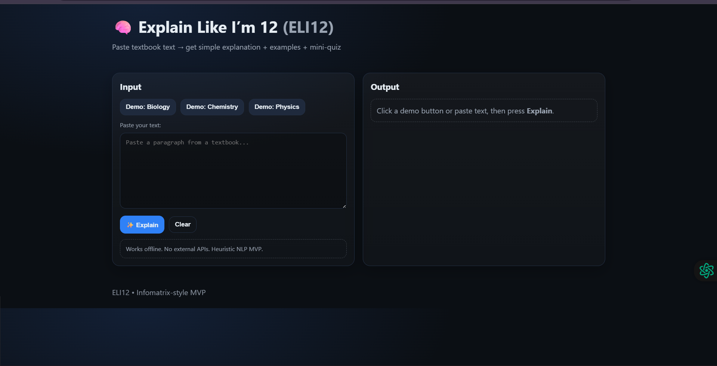
Live Demo
Single-page web app (GitHub Pages).
Product view
Notes:
[
Sources
]

Slide 5
Core Features
Designed for fast comprehension + quick self-check.
Student workflow
Convenience
Pick a demo or paste a paragraph
Get simplified explanation (level 1–3)
See key terms + glossary
Review examples
Answer mini-quiz (with suggested answers)
Copy results for notes
Download results as .txt
Works offline
Single page, fast UI
Notes:
[
Sources
]

Slide 6
How it works (Tech)
Lightweight heuristics—no external AI required for MVP.
Pipeline (offline)
Text preprocessing
Normalize whitespace, sentence split
Subject detection
Keyword hints: Biology / Chemistry / Physics
Hard-word detection
Length + suffix rules (e.g., “-ция”, “-изм”, “-ness”)
Simplification
Replace connectors (“however”→“but”), shorten & rephrase by level
Study outputs
Key terms + glossary + examples + quiz + suggested answers
Notes:
[
Sources
]

Slide 7
Impact
A practical study tool that works even with limited connectivity.
Use cases
Benefits
Before tests: quick recap + quiz
Homework: understand the main idea faster
Vocabulary: learn key terms from paragraphs
Offline classroom / rural internet
Less frustration, faster comprehension
Better retention via examples
Self-check with suggested answers
Easy to share/export study notes
Notes:
[
Sources
]

Slide 8
Roadmap
What we’ll improve next (post-hackathon).
Next iterations
Stronger simplification (more robust language rules)
Better personalization (age/grade toggle)
Teacher mode: generate worksheets & track progress
Multilingual packs (RU/KZ/EN)
Optional AI mode (when internet is available)
Live demo: GitHub Pages • Repo: GitHub • Video: YouTube
Notes:
[
Sources
]

